Slide 1

Innovating digital manufacturing
By:
Nathan M. Diwambuena ( Team Leader)
Nicholas Octavius
Olemanu G. Lohalo
Kashosi Gad David
Henrique B. Zayzay

Slide 2
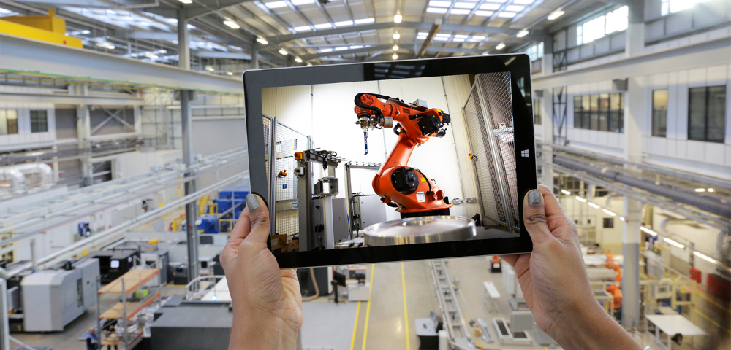
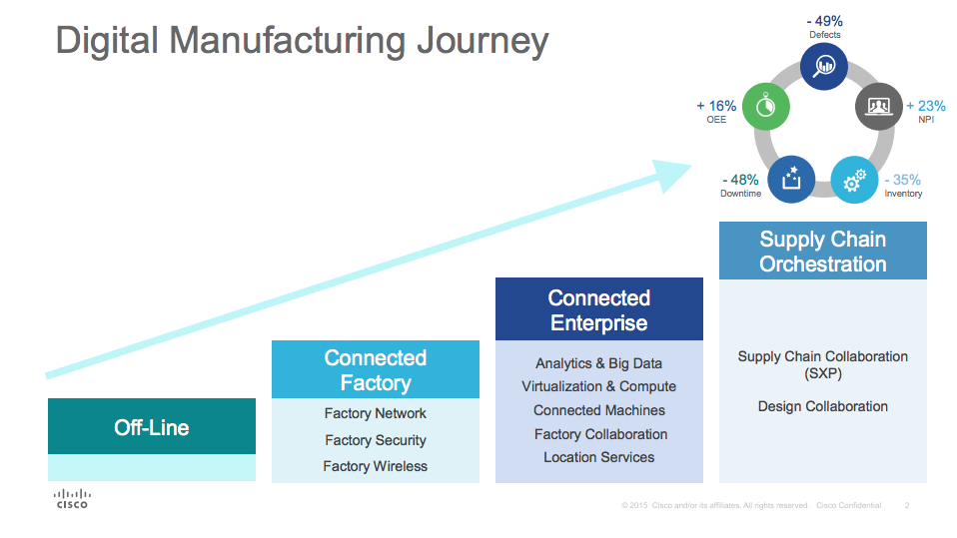
What is Digital Manufacturing?
Digital Manufacturing is a term used to describe the integrated use of automated systems, processes and tools in design and manufacturing organizations to deliver products to clients as quickly as feasible, and with the minimum of operator intervention.
Notes:
So just what is Digital Mfg? ARC defines Digital Mfg as: (read definition)
Here a robotic welding cell is defined virtually and then can be placed within the virtually defined production line. Production systems like this can be components of an entire virtual factory layout.

Slide 3
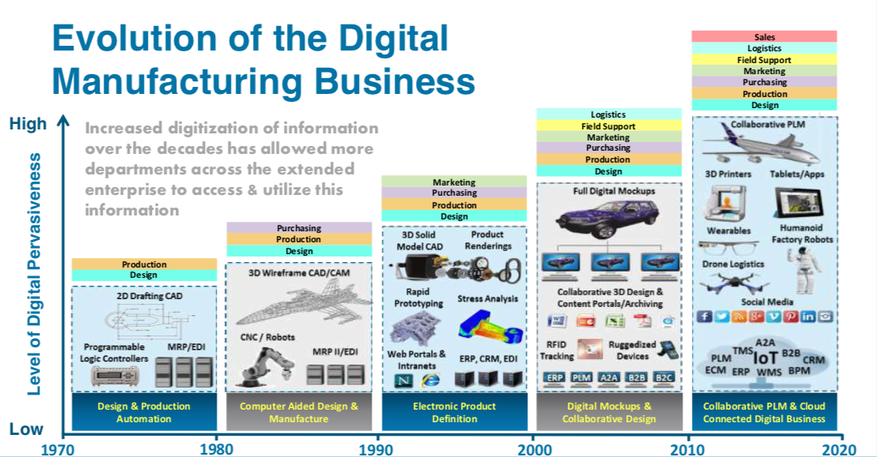
Evolution and Benefits
Benefits :
Enhances productivity
Reduces costs
Flexible design and production
High quality prototypes

Slide 4
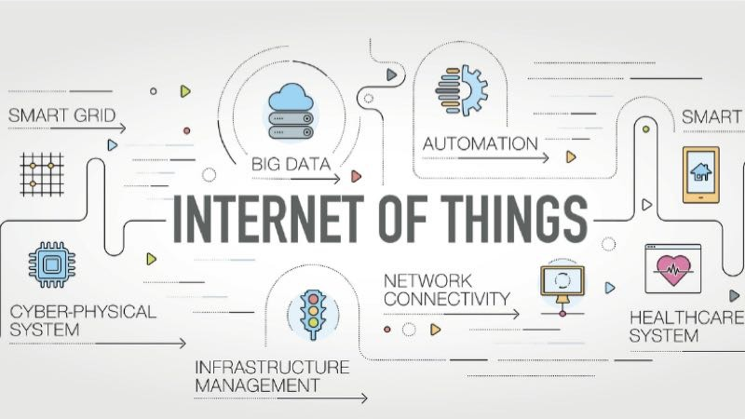
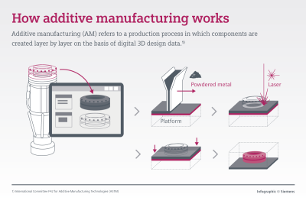
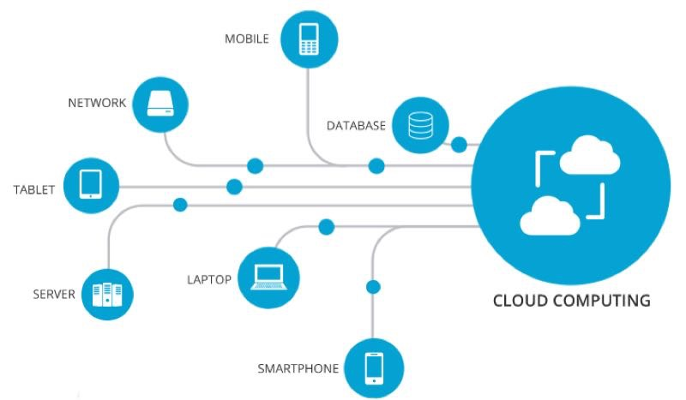
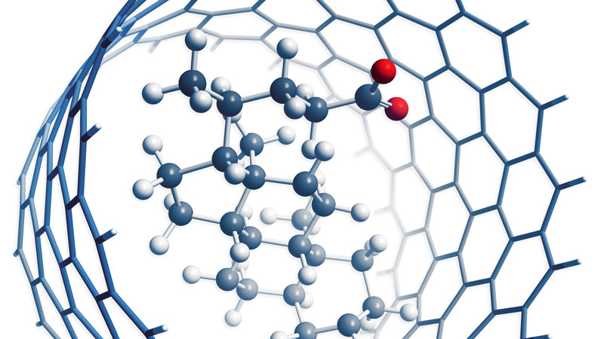
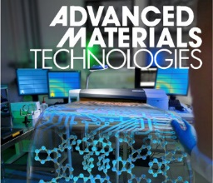
Five Most Influential Manufacturing Tech Innovations
Additive Manufacturing / 3D Printing
Nanotechnology
(Deals with matter between 1 and 100 nanometers; 1 nanometer = one-billionth of a meter).
Fortify
Higher Efficiency
Reduce Waste
Increasing Applications
Higher Durability
Chemical Safety
Counter Resource Shortage
Other specialized improvements

Slide 5
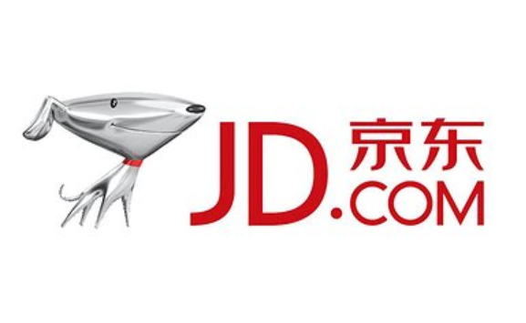
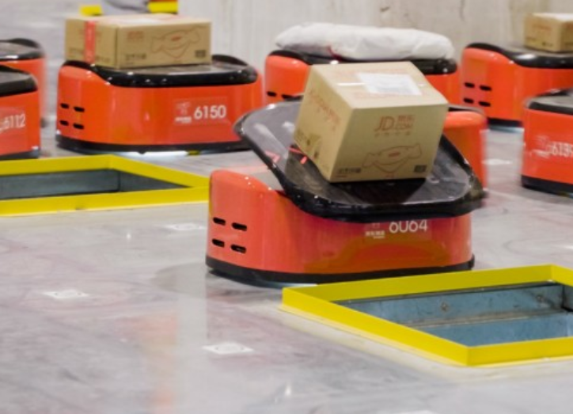
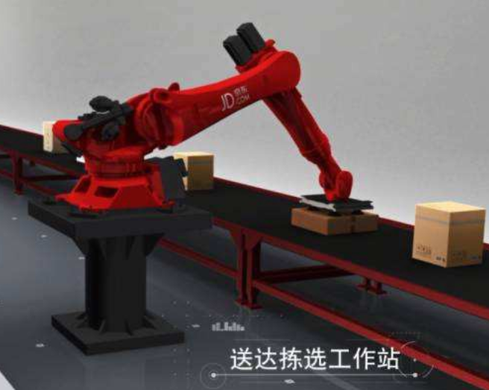




Cases of Applied Digital Technology
Although it is not a manufacturing company, JD.com, China’s second biggest e-commerce company is eager in applying digital technologies in processes that are highly related to manufacturing such as automated item distribution and packaging, massive data management system and cloud system which are all installed in their unmanned warehouse.
MINI Yours, with their slogan “Next Level of Individualization”, is a parts and accessories personalization provided by MINI. This service is possible thanks to their advance 3D printing application that can easily create items based on specific requirements.

Slide 6
Challenges
The customization is a global trend and is likely to spread more rapidly across manufacturing industry in the future.
The scope for networking represented by digital industry transformation offer interesting opportunities for manufacturing companies to make more extensive, more efficient and more flexible use of this trend than they are currently able to.
The most challenges posed by digital industry transformation are :
Managing Data
Risks to data security
Question of resources
Role of Government
Technological
Global challenges

Slide 7
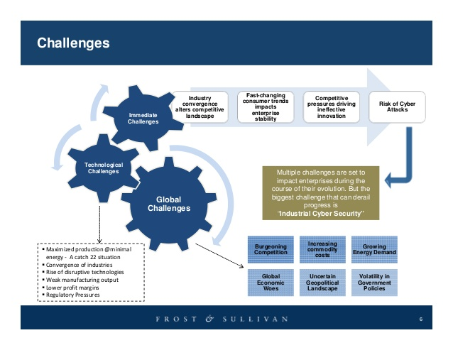
Challenges

Slide 8
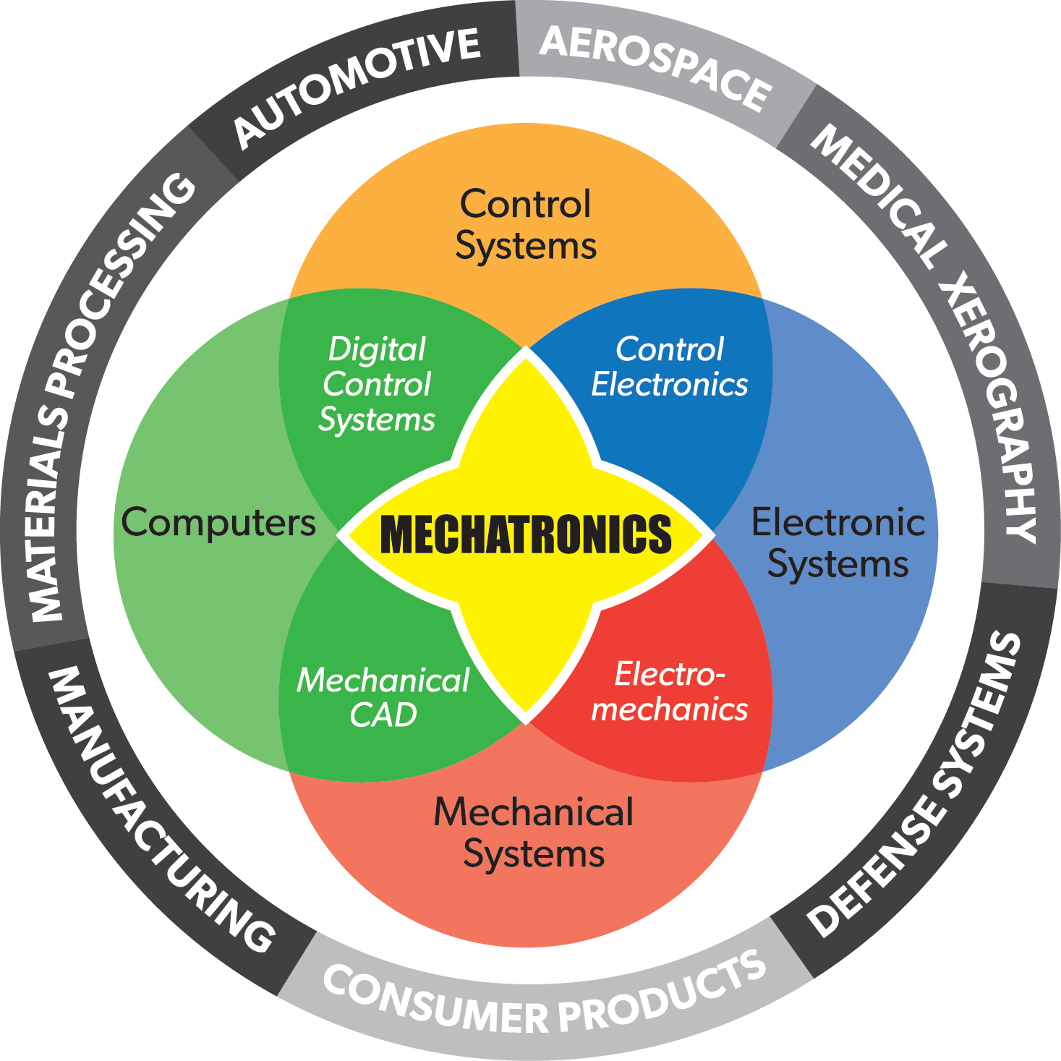
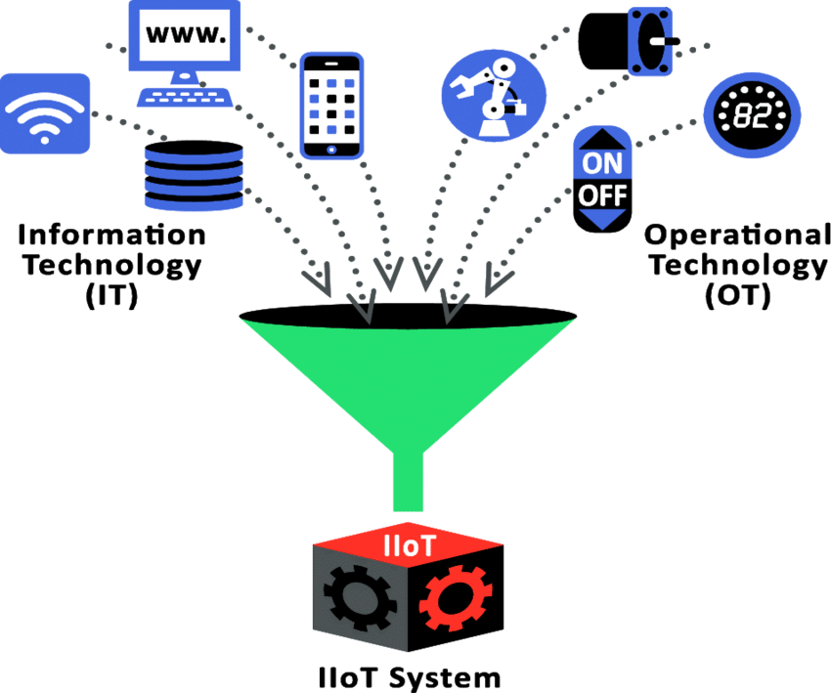
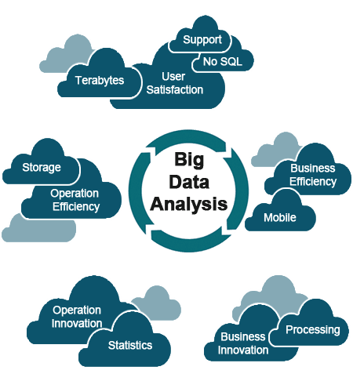
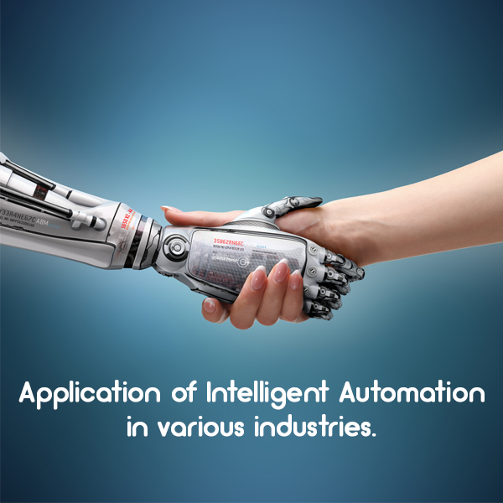
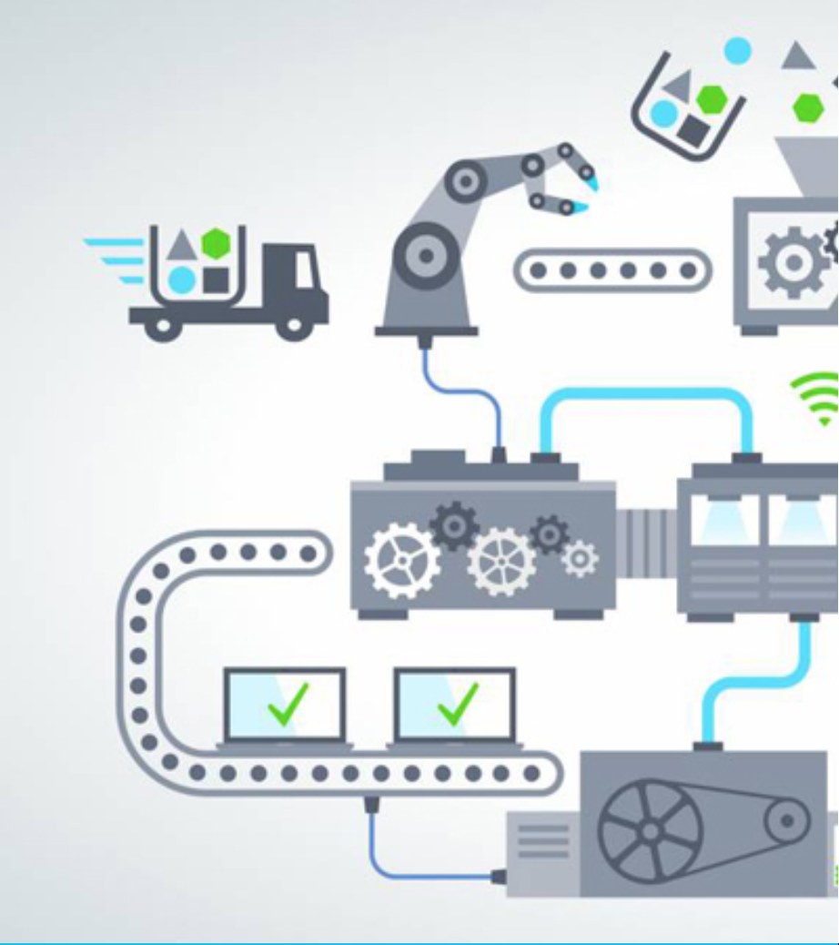


Predictions : 5 Trends
Smart Mechatronics
Big Data and Analysis
Intelligent Automation
Intelligent Supply Chain
IT/OT
Cyber-physical System

Slide 9


10 Predictions for Global Manufacturing : IDC
By 2020, 60% of the top manufacturers will rely on digital platforms that support as much as 30% of their overall revenue.
By 2020, 75% of all manufacturers will participate in industry clouds.
By 2020, 80% of supply chain interactions will happen across cloud-based commerce networks, dramatically improving participants' resiliency and reducing the impact of supply disruptions by up to one-third.
Etc.
Specific utilized technology :
Integrated Workflows
Mobile Collaboration
Machine Learning & AI
Analytics
IoT

Slide 10
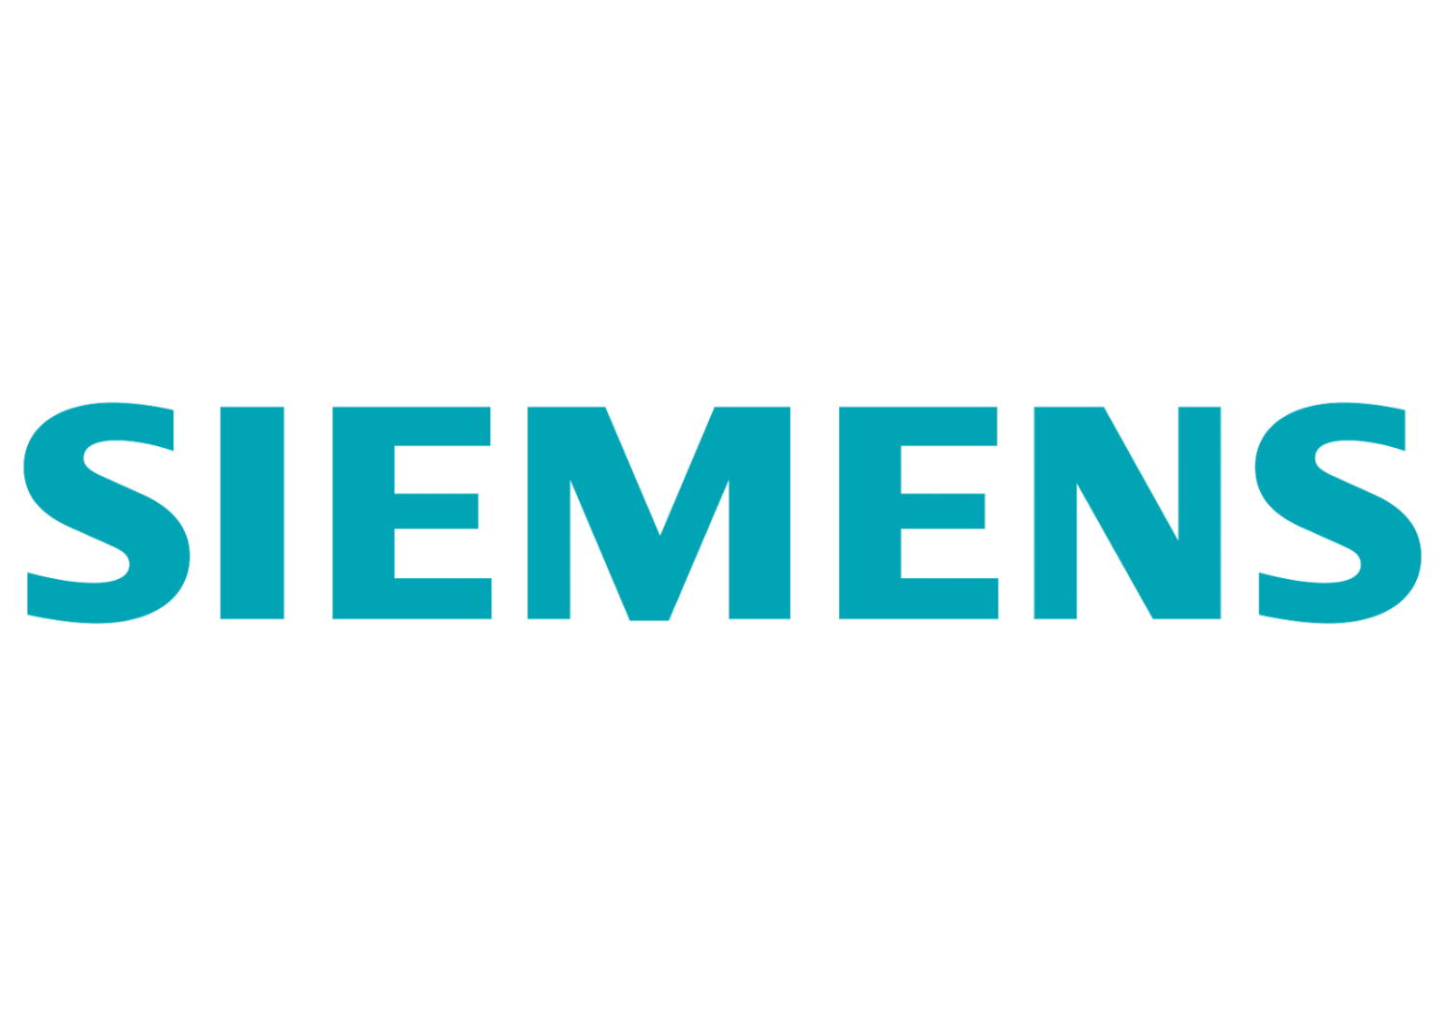


Business Opportunities and Application
Capgemini estimates the size of the connected products market globally will range between $519B to $685B by 2020.
60 % of manufacturers are struggling to ensure digital continuity throughout their entire product lifecycles.
54% of manufacturers have initiated programs to enable collaboration and greater innovation with start-ups, third parties, and suppliers, expanding their digital ecosystems to include co-creators in new product development.
Business
Government actions
Individual level
Raising funds to enterprises in order to make technology resources available to them.
Encouraging entrepreneurship and innovation in society, education etc.
Elaborate regulations.
Learning with the purpose of contributing in the society with real actions.
Creating startups and enterprises to provide solution of digital manufacturing needs

Slide 11
Thank You!
Special thanks to Mr. Kris Singh

